Slide 1

Predicting Wine Rating
Benjamin, Carrie, Parker and Ryan

Slide 2
Wine

Slide 3
Wines by Type
Red – Cabernet sauvignon, Merlot, Pinot Noir, Zinfandel
Rosé – Zinfandel Rosé, Pinot Noir Rosé, Tempranillo Rosé, Syrah Rosé
Sparkling – Champagne, Prosecco
White – Chardonnay, Pinot Grigio, Riesling, Moscato, Sauvignon Blanc

Slide 4
Wine Characteristics
Acidity
Body
Sweetness/Dryness
Tannins

Slide 5
How Region Affects Wine
Climate
Soil
Topography

Slide 6
Tasting and Rating
Color
Swirling
Smell
Taste
Savoring

Slide 7
Data & Modeling

Slide 8
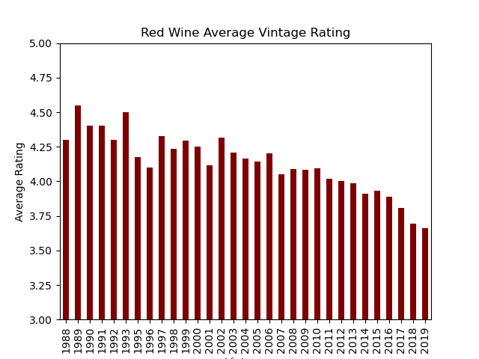
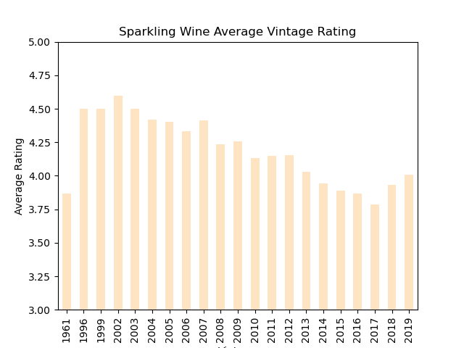
Average Vintage Rating

Slide 9
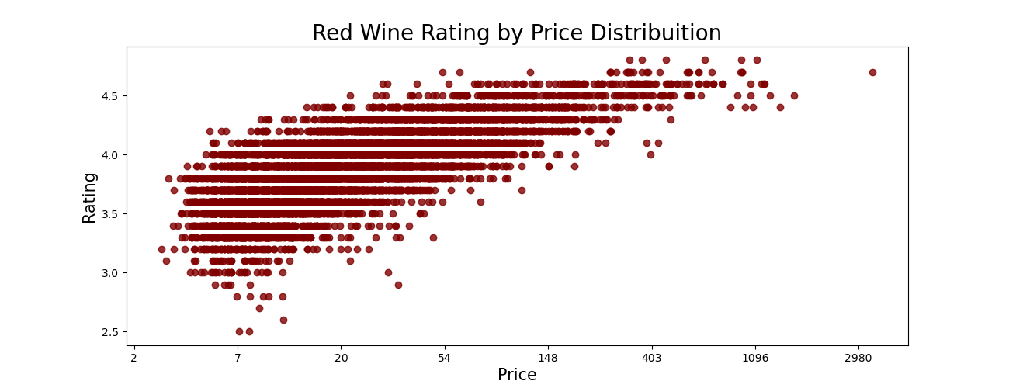
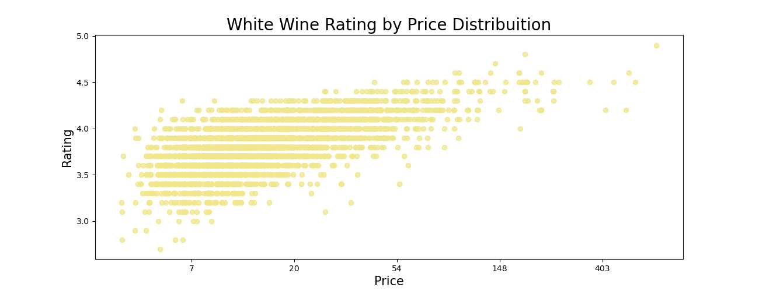
Rating by Price

Slide 10
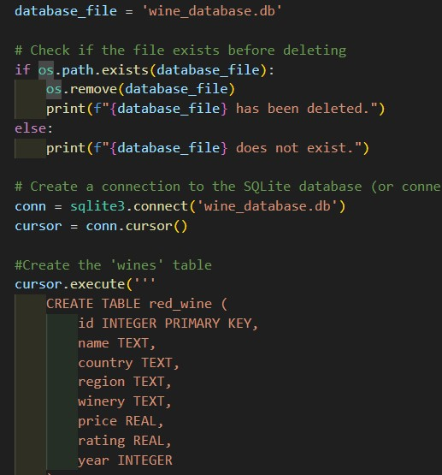
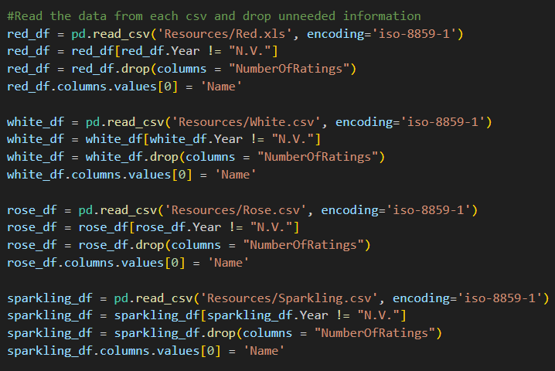
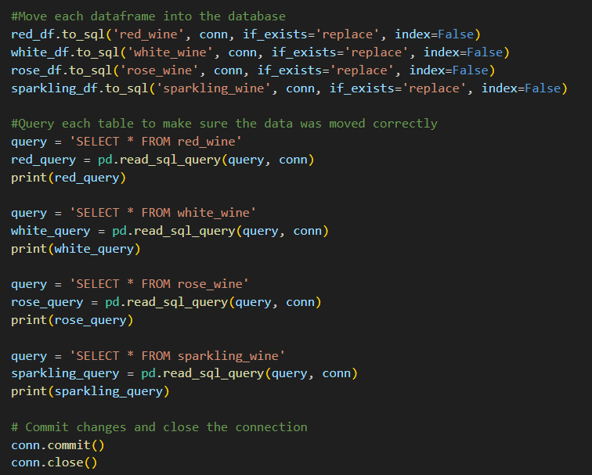
Building SQLite Database

Slide 11
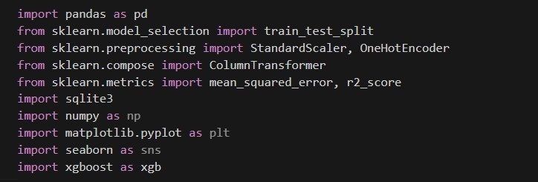
Dependencies

Slide 12
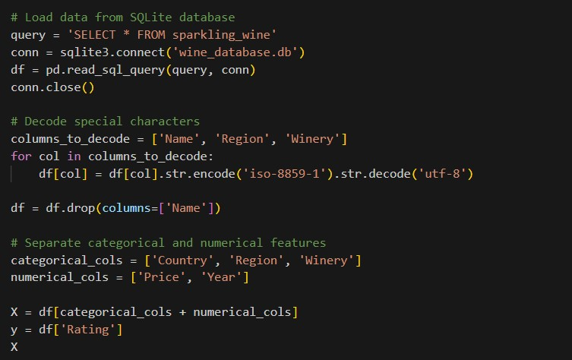
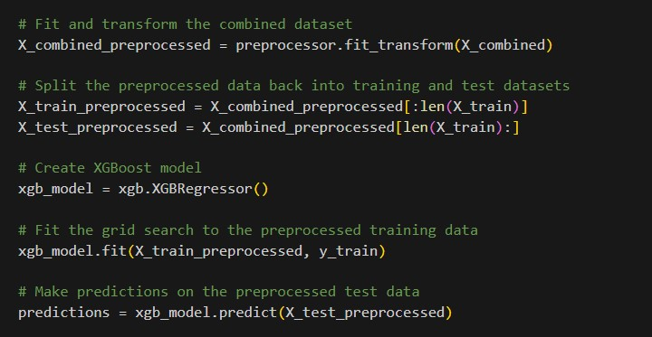
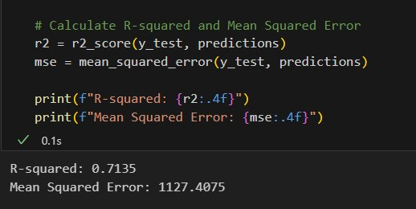
Modeling

Slide 13
Analysis

Slide 14
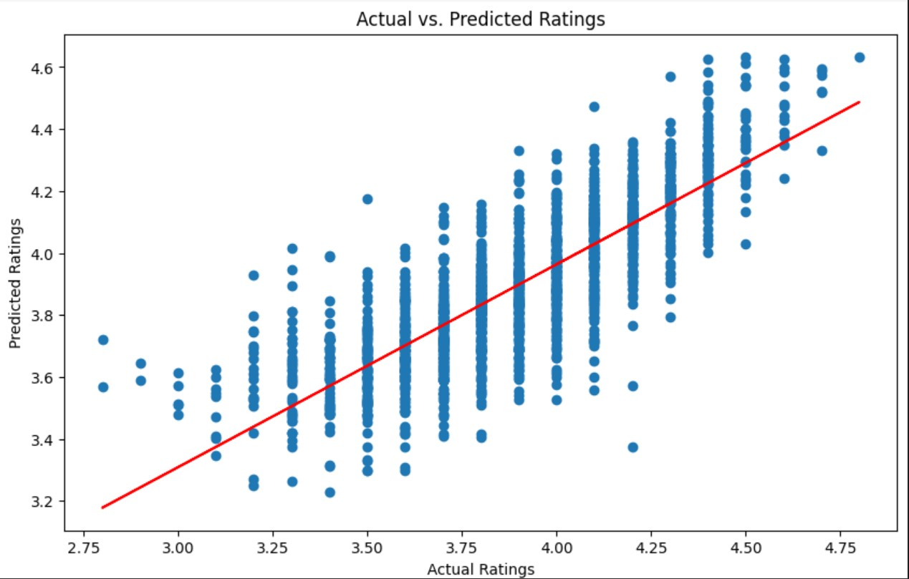
Actual vs Predicted Ratings (Red)

Slide 15
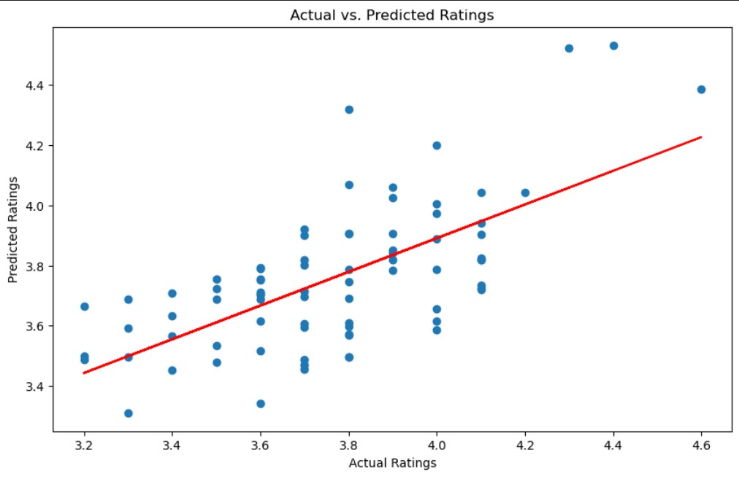
Actual vs Predicted Ratings (Rosé)

Slide 16
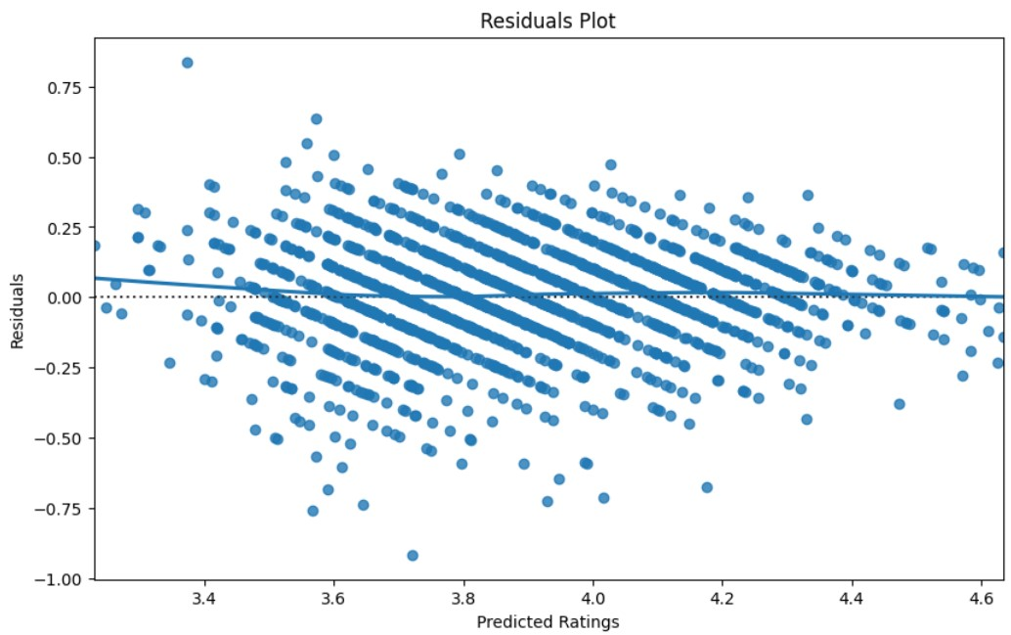
Residuals Plot (Red)

Slide 17
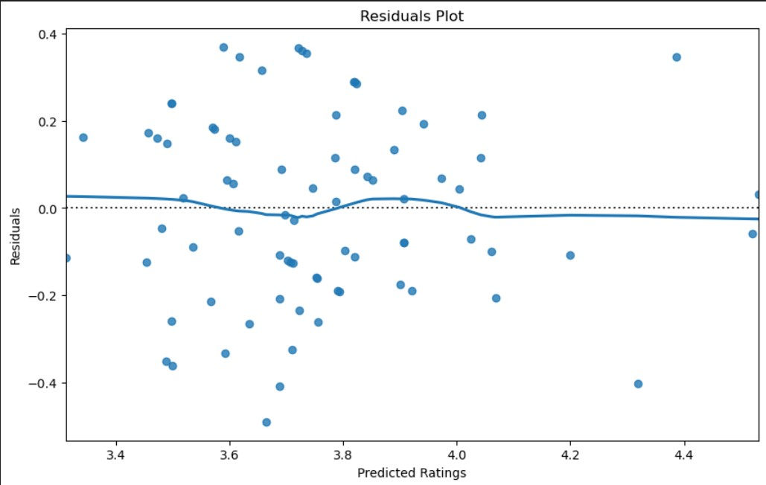
Residuals Plot (Rosé)

Slide 18
Maps
https://public.tableau.com/app/profile/benjamin.moran8875/viz/Wine_project

Slide 19
References
https://www.kaggle.com/code/budnyak/wines-eda-and-rating-prediction/input?select=Red.csv
https://www.kaggle.com/code/budnyak/wines-eda-and-rating-prediction/notebook
https://www.amli.com/blog/different-wines-and-how-theyre-made
https://perrinesproduce.com/2020/01/20/how-different-regions-of-the-world-affect-the-taste-of-wine
https://www.jjbuckley.com/wine-knowledge/blog/exactly-how-do-professional-critics-rate-and-rank-wine

